Slide 1

An Empirical Study of
Code Smells in Transformer-based
Code Generation Techniques
Mohammed Latif Siddiq
msiddiq3@nd.edu
Shafayat H. Majumder
1705080@ugrad.cse.buet.ac.bd
Maisha R. Mim
1705060@ugrad.cse.buet.ac.bd
Sourov Jajodia
1705072@ugrad.cse.buet.ac.bd
Joanna C. S. Santos
joannacss@nd.edu
Bangladesh University of Engineering and Technology
Notes:
Hello everyone.
In this presentation, we are going to talk about our empirical investigation on the presences of the code smell in code generation dataset and in the output of transformer-based model.

Slide 2
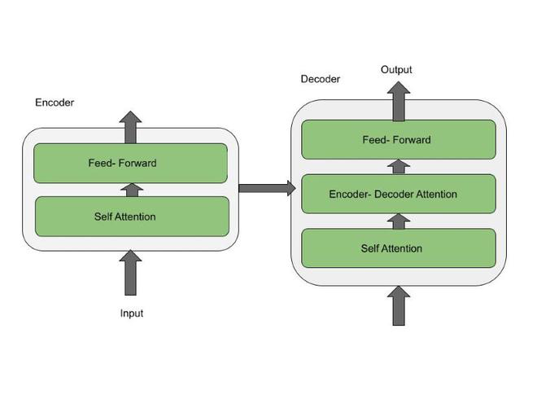




An Overview of Transformer-based
Code Generation Techniques
Transformer-based
Large Language Model
Code Generation Dataset
Generated Source Code
Notes:
The transformer is an encoder- decoder architecture-based deep learning model that uses the self-attention mechanism for differentially weighting the significance of each part of the input data.
It powers the current hike of large language model. To generation code, we need training set collected from open source data.

Slide 3
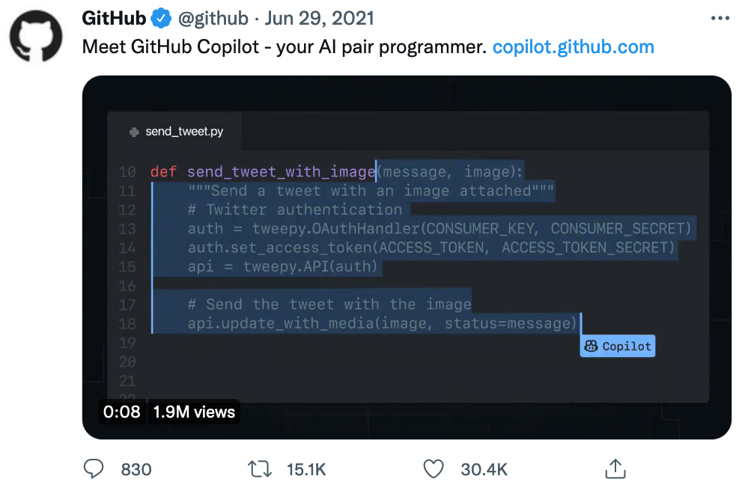

Prompt and Code Generation Tool
GPT-Code-Clippy (GPT-CC)

Slide 4


What are Code smells and Security smells?
Code smells are symptoms that may indicate the system has flaws
Security code smells (or simply “security smells”) are a subset of code smells that may lead to security flaws.
https://martinfowler.com/bliki/CodeSmell.html

Slide 5
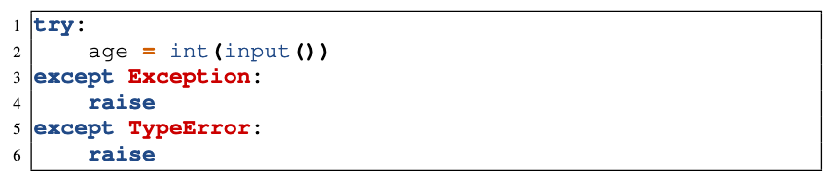
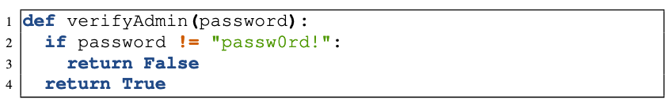
Example of Code Smells and Security Smells
Using the wrong exception catching order
Use of Hard-coded Credentials (CWE-798)

Slide 6
Prior Research and Motivation
Verifying whether the generated code is functionally correct but not the quality of the generated code.
Investigating whether GitHub Copilot can generate vulnerable code or whether it is as bad as humans in generating insecure code.
Lack of an in-depth understanding of the quality of training datasets and whether code smells can potentially leak into the code generated by these models.

Slide 7



Overview of the Study
Scope: Python
Transformer-based
Large Language Model
Code Generation Dataset
Generated Source Code
Convention
Error
Warning
Refactor
Code smells in generated code
RQ2: open source techniques
RQ3: closed source techniques
RQ1: code smells in training sets
Security Smells

Slide 8
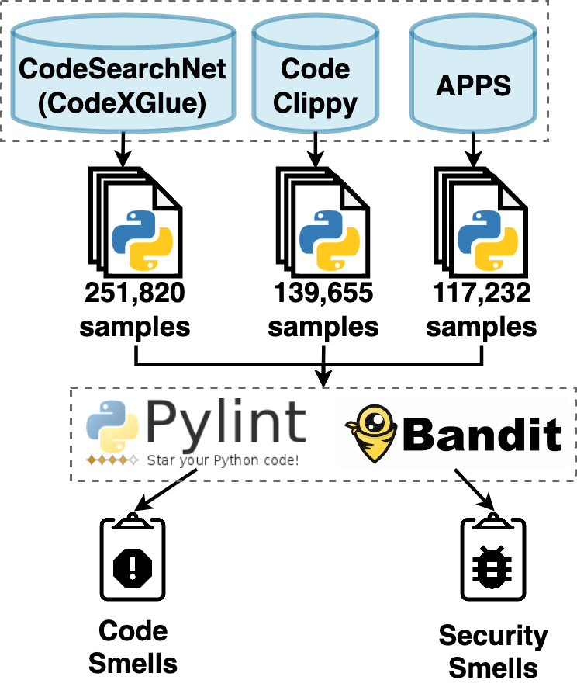
RQ1: Are code smells present in the code generation training datasets?
Dataset | “Smelly” Samples (non-security) | Smelly Samples (security-related)
APPS | 69.15% | 1.62%
Code Clippy | 39.12% | 10.27%
CodeXGlue | 97.03% | 5.32%

Slide 9
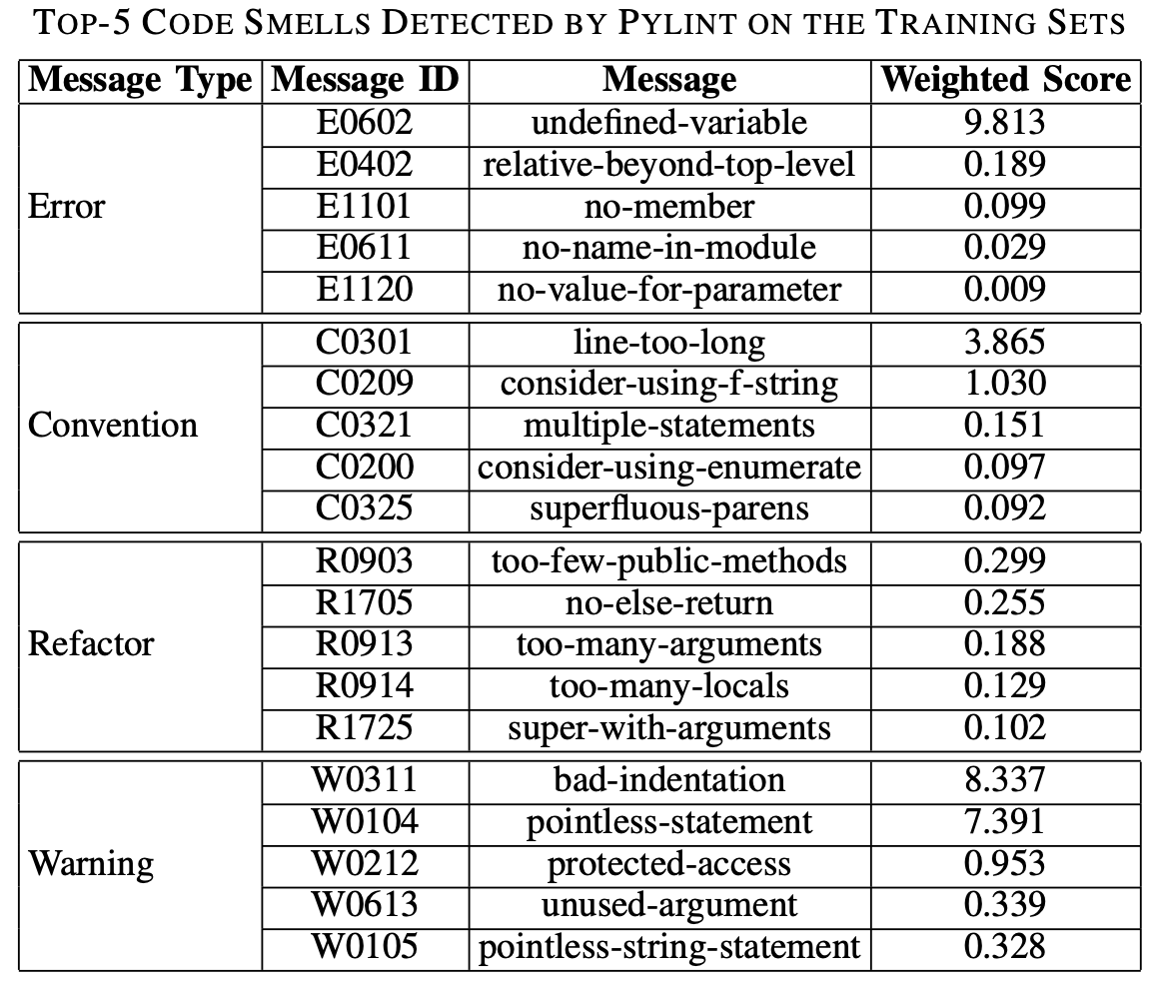
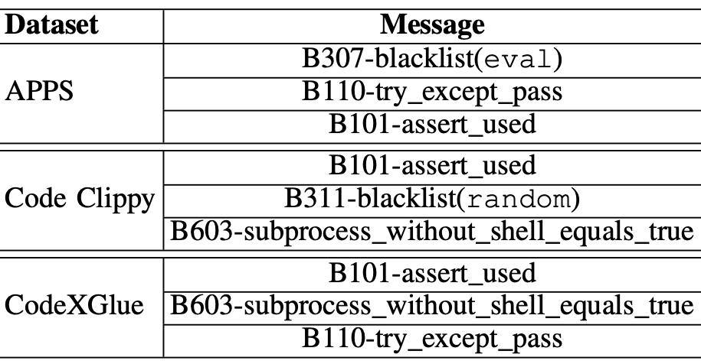
RQ1: Are code smells present in the code generation training datasets?

Slide 10
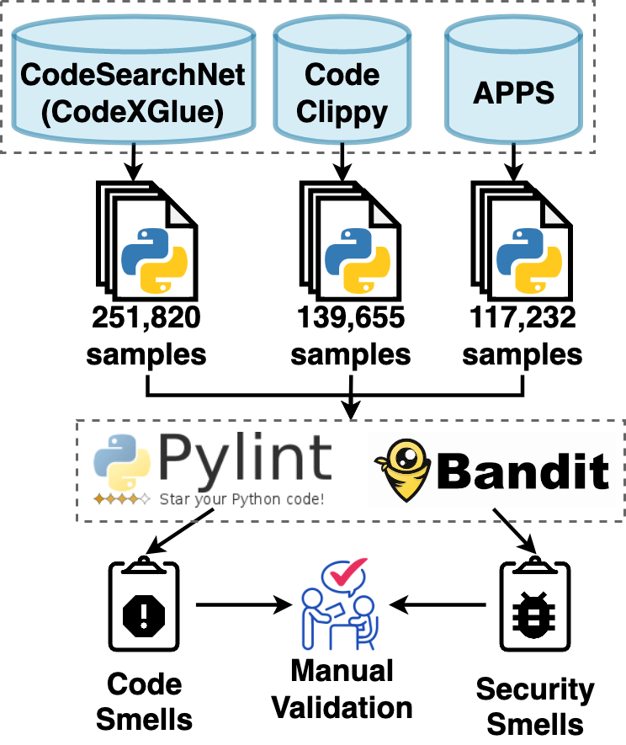
Manual Validation for the Analyzers
Confidence Level = 95%
Margin of Error = 5%
Analyzers | # of Samples | Precision
Pylint | 384 | 100%
Bandit | 380 | 90.79%

Slide 11
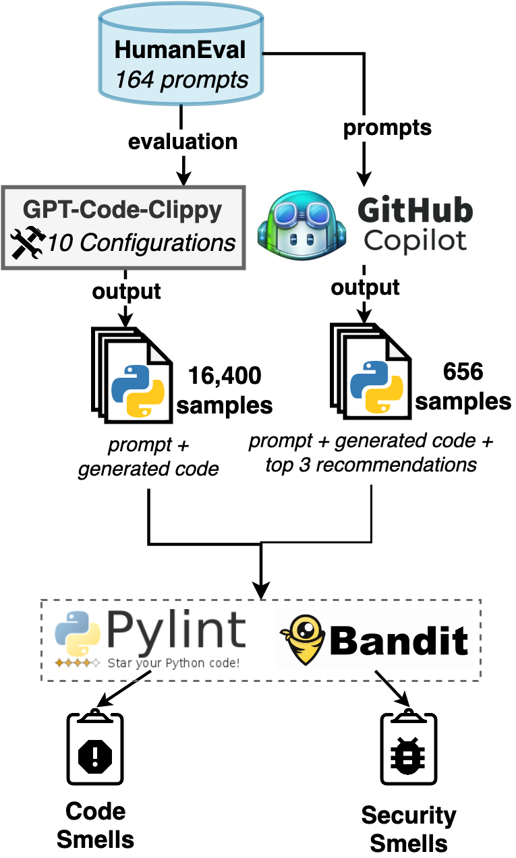
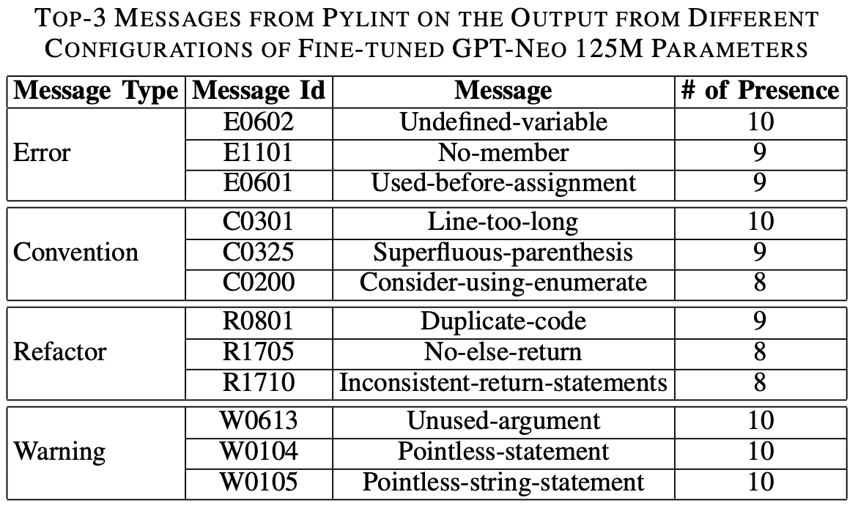
RQ2: Does the output of an open-source code generation technique contain code smells?
Top security smells:
Improper check or handling exceptional condition
Use of blacklisted function i.e. eval, random

Slide 12
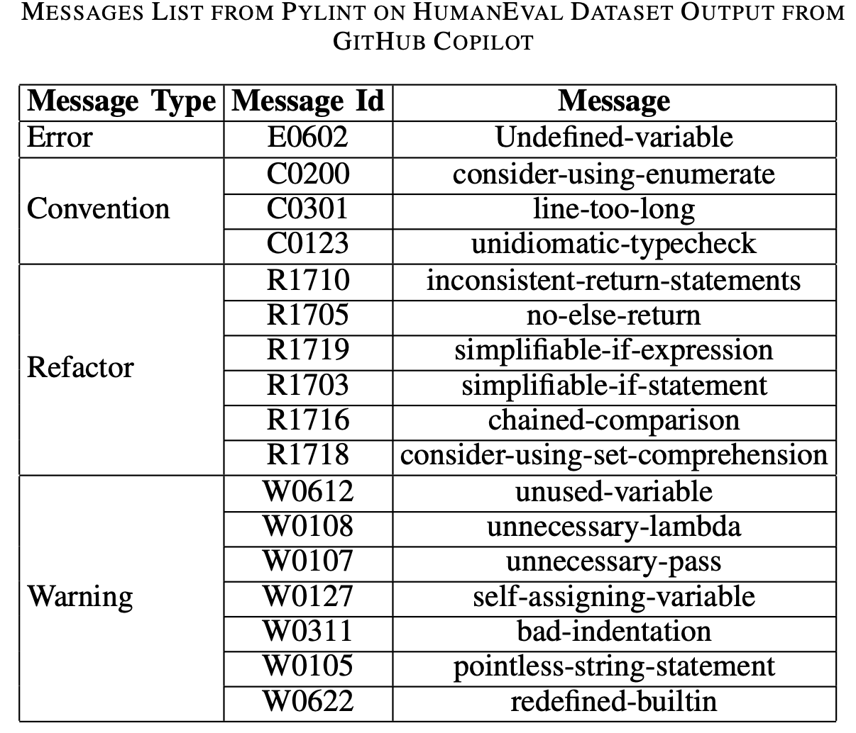
RQ3: Is there any code smell in the output of closed source code generation tools?
Top Security smells:
Improper check or handling exceptional condition
Use of blacklisted function i.e. eval
Use of weak hash functions (MD2, MD4, MD5, or SHA1)

Slide 13
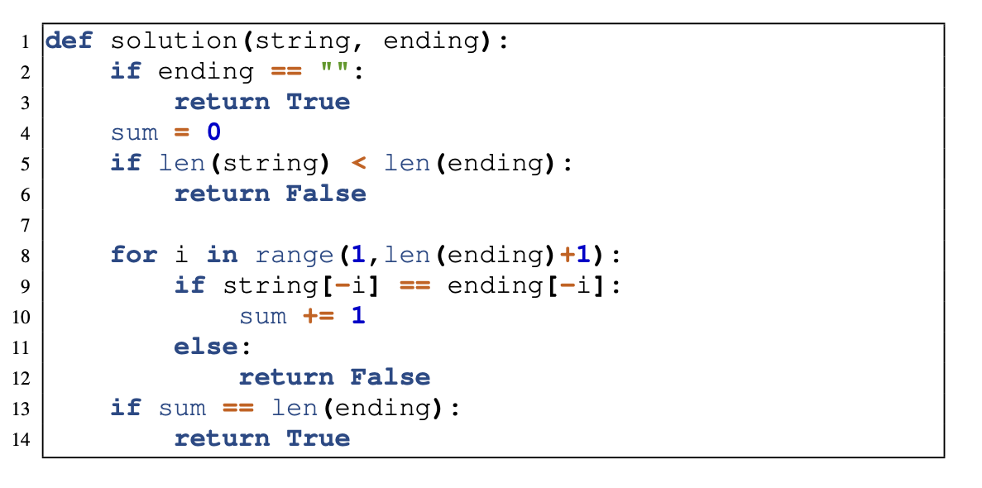
Examples of Generated Smelly Code
Inconsistent Return Statement

Slide 14
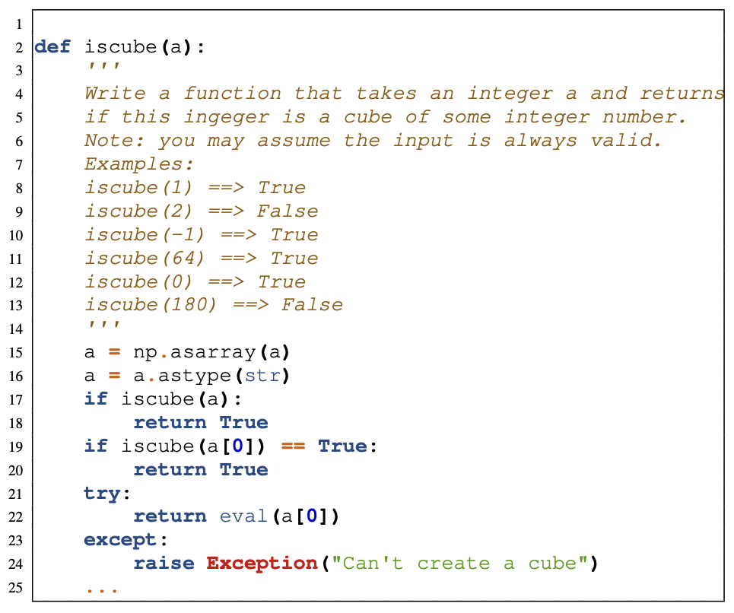
Examples of Generated Smelly Code
Use of Possible Insecure Function

Slide 15
Implication of the Findings
For Developers:
Bad patterns leak to the model’s output
Smells in the output of a model is a subset of the smell found in the dataset
Proper checking of the code generation output
Taking generated code “as is” could lead to a software quality issue.
Using static analyzers and linters for vetting the code generation output
For Researcher:
Preprocessing the dataset
Remove and repair smelly samples in the dataset

Slide 16
Conclusion
Transformer-based
Large Language Model
Code Generation Dataset
Generated Source Code
Code smells in generated code
RQ2: open source techniques
RQ3: closed source techniques
RQ1: code smells in training sets
Code Smells | Undefined Variables | Not using enumerate | Inconsistent return statements
Security Smells | Using Assert | Blacklisted Functions | Improper use of Subprocess Function

Slide 17






An Empirical Study of Code Smells in Transformer-based Code Generation Techniques
Mohammed Latif Siddiq
msiddiq3@nd.edu
Shafayat H. Majumder
1705080@ugrad.cse.buet.ac.bd
Maisha R. Mim
1705060@ugrad.cse.buet.ac.bd
Sourov Jajodia
1705072@ugrad.cse.buet.ac.bd
Joanna C. S. Santos
joannacss@nd.edu
Preprint
Source Code
Contact
Any Questions?

Slide 18
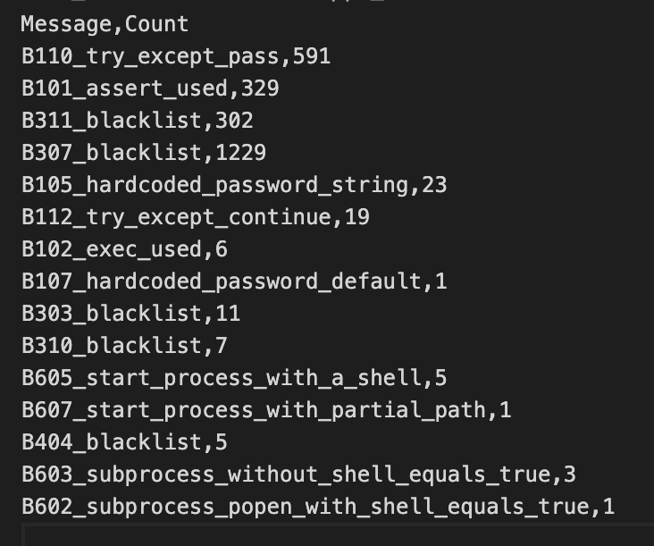
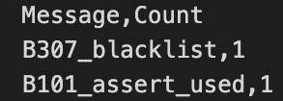
Leakage
Security Smell list from the Output of Fine-tuned GPT-Neo with APPS
Security Smell list in APPS Dataset

Slide 19
Threats to validity
1. Only for Python
2. Focused on GPT-Code-Clippy model
3. External tool: Pyline and Bandit
4. Not covering all code smell and security smell
5. Three training datasets and an evaluation dataset

